Slide 1

Cryptography and Network Security
Seventh Edition
by William Stallings
Notes:
Lecture slides prepared for “Cryptography and Network Security”, 7/e, by William Stallings, Chapter 9 – “Public Key Cryptography and RSA”.

Slide 2
Chapter 9
Public Key Cryptography and RSA
Notes:
The development of public-key cryptography is the greatest and perhaps the
only true revolution in the entire history of cryptography. From its earliest beginnings
to modern times, virtually all cryptographic systems have been based on
the elementary tools of substitution and permutation. After millennia of working
with algorithms that could be calculated by hand, a major advance in symmetric
cryptography occurred with the development of the rotor encryption/decryption
Machine. The electromechanical rotor enabled the development of fiendishly complex
Cipher systems. With the availability of computers, even more complex systems
were devised, the most prominent of which was the Lucifer effort at IBM that culminated
in the Data Encryption Standard (DES). But both rotor machines and DES,
although representing significant advances, still relied on the bread-and-butter tools
of substitution and permutation.
Public-key cryptography provides a radical departure from all that has gone
before. For one thing, public-key algorithms are based on mathematical functions
rather than on substitution and permutation. More important, public-key cryptography
is asymmetric, involving the use of two separate keys, in contrast to symmetric
encryption, which uses only one key. The use of two keys has profound
consequences in the areas of confidentiality, key distribution, and authentication,
as we shall see.
This chapter and the next provide an overview of public-key cryptography.
First, we look at its conceptual framework. Interestingly, the concept for this
technique was developed and published before it was shown to be practical to
adopt it. Next, we examine the RSA algorithm, which is the most important encryption/
decryption algorithm that has been shown to be feasible for public-key
encryption. Other important public-key cryptographic algorithms are covered in
Chapter 10.
Much of the theory of public-key cryptosystems is based on number theory.
If one is prepared to accept the results given in this chapter, an understanding of
number theory is not strictly necessary. However, to gain a full appreciation of
public-key algorithms, some understanding of number theory is required. Chapter 2
provides the necessary background in number theory.

Slide 3
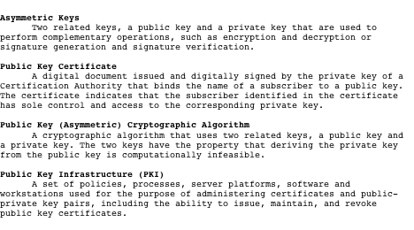
Table 9.1
Terminology Related to Asymmetric Encryption
Source: Glossary of Key Information Security Terms, NIST IR 7298 [KISS06]
Notes:
Table 9.1 defines some key terms.

Slide 4

Misconceptions Concerning
Public-Key Encryption
Public-key encryption is more secure from cryptanalysis than symmetric encryption
Public-key encryption is a general-purpose technique that has made symmetric encryption obsolete
There is a feeling that key distribution is trivial when using public-key encryption, compared to the cumbersome handshaking involved with key distribution centers for symmetric encryption
Notes:
Before proceeding, we should mention several common misconceptions concerning
public-key encryption. One such misconception is that public-key encryption
is more secure from cryptanalysis than is symmetric encryption. In fact, the
security of any encryption scheme depends on the length of the key and the computational
work involved in breaking a cipher. There is nothing in principle about
either symmetric or public-key encryption that makes one superior to another from
the point of view of resisting cryptanalysis.
A second misconception is that public-key encryption is a general-purpose
technique that has made symmetric encryption obsolete. On the contrary, because
of the computational overhead of current public-key encryption schemes, there
seems no foreseeable likelihood that symmetric encryption will be abandoned. As
one of the inventors of public-key encryption has put it [DIFF88], “the restriction
of public-key cryptography to key management and signature applications is almost
universally accepted.”
Finally, there is a feeling that key distribution is trivial when using public-key
encryption, compared to the rather cumbersome handshaking involved with
key distribution centers for symmetric encryption. In fact, some form of protocol
is needed, generally involving a central agent, and the procedures involved are not
simpler nor any more efficient than those required for symmetric encryption (e.g.,
see analysis in [NEED78]).

Slide 5
Principles of Public-Key Cryptosystems
The concept of public-key cryptography evolved from an attempt to attack two of the most difficult problems associated with symmetric encryption:
Whitfield Diffie and Martin Hellman from Stanford University achieved a breakthrough in 1976 by coming up with a method that addressed both problems and was radically different from all previous approaches to cryptography
Notes:
The concept of public-key cryptography evolved from an attempt to attack two of
the most difficult problems associated with symmetric encryption. The first problem
is that of key distribution, which is examined in some detail in Chapter 14.
As Chapter 14 discusses, key distribution under symmetric encryption requires
either (1) that two communicants already share a key, which somehow has been distributed
to them; or (2) the use of a key distribution center. Whitfield Diffie, one
of the discoverers of public-key encryption (along with Martin Hellman, both at
Stanford University at the time), reasoned that this second requirement negated
the very essence of cryptography: the ability to maintain total secrecy over your
own communication. As Diffie put it [DIFF88], “what good would it do after all to
develop impenetrable cryptosystems, if their users were forced to share their keys
with a KDC that could be compromised by either burglary or subpoena?”
The second problem that Diffie pondered, and one that was apparently
unrelated to the first, was that of digital signatures . If the use of cryptography
was to become widespread, not just in military situations but for commercial and
private purposes, then electronic messages and documents would need the equivalent
of signatures used in paper documents. That is, could a method be devised
that would stipulate, to the satisfaction of all parties, that a digital message had
been sent by a particular person? This is a somewhat broader requirement than
that of authentication, and its characteristics and ramifications are explored in
Chapter 13.
Diffie and Hellman achieved an astounding breakthrough in 1976
[DIFF76 a, b] by coming up with a method that addressed both problems and was
radically different from all previous approaches to cryptography, going back over
four millennia.

Slide 6
Public-Key Cryptosystems
A public-key encryption scheme has six ingredients:
Notes:
Asymmetric algorithms rely on one key for encryption and a different but related
key for decryption. These algorithms have the following important characteristic.
• It is computationally infeasible to determine the decryption key given only
knowledge of the cryptographic algorithm and the encryption key.
In addition, some algorithms, such as RSA, also exhibit the following characteristic.
• Either of the two related keys can be used for encryption, with the other used
for decryption.
A public-key encryption scheme has six ingredients (Figure 9.1a; compare
with Figure 3.1).
• Plaintext: This is the readable message or data that is fed into the algorithm as
input.
• Encryption algorithm: The encryption algorithm performs various transformations
on the plaintext.
• Public and private keys: This is a pair of keys that have been selected so that
if one is used for encryption, the other is used for decryption. The exact transformations
performed by the algorithm depend on the public or private key
that is provided as input.
• Ciphertext: This is the scrambled message produced as output. It depends on
the plaintext and the key. For a given message, two different keys will produce
two different ciphertexts.
• Decryption algorithm: This algorithm accepts the ciphertext and the matching
key and produces the original plaintext.

Slide 7
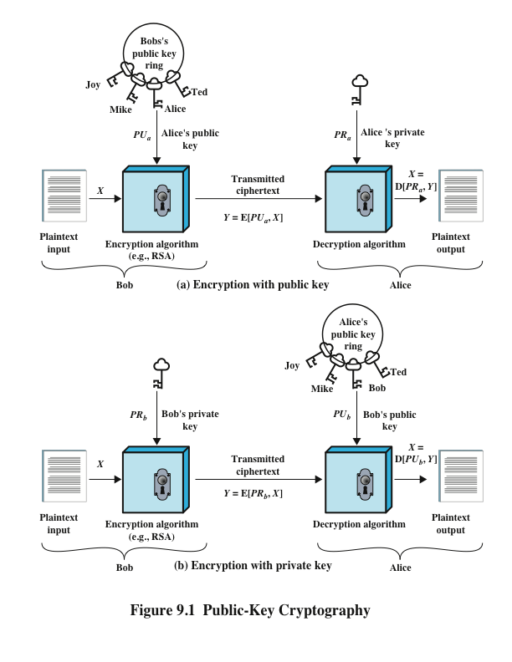
Notes:
The essential steps are the following.
1. Each user generates a pair of keys to be used for the encryption and decryption
of messages.
2. Each user places one of the two keys in a public register or other accessible
file. This is the public key. The companion key is kept private. As Figure 9.1a
suggests, each user maintains a collection of public keys obtained from others.
3. If Bob wishes to send a confidential message to Alice, Bob encrypts the message
using Alice’s public key.
4. When Alice receives the message, she decrypts it using her private key. No
other recipient can decrypt the message because only Alice knows Alice’s private
key.
With this approach, all participants have access to public keys, and private
keys are generated locally by each participant and therefore need never be
distributed. As long as a user’s private key remains protected and secret, incoming
communication is secure. At any time, a system can change its private key and
publish the companion public key to replace its old public key.

Slide 8
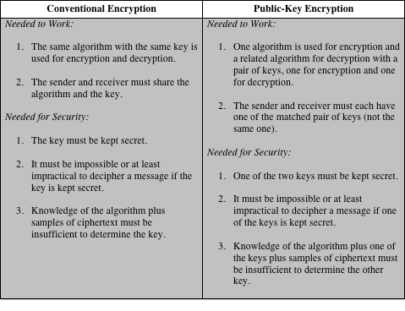
Table 9.2
Conventional and Public-Key Encryption
Notes:
Table 9.2 summarizes some of the important aspects of symmetric and public-key
encryption. To discriminate between the two, we refer to the key used in symmetric
encryption as a secret key . The two keys used for asymmetric encryption are
referred to as the public key and the private key . Invariably, the private key is kept
secret, but it is referred to as a private key rather than a secret key to avoid confusion
with symmetric encryption.

Slide 9
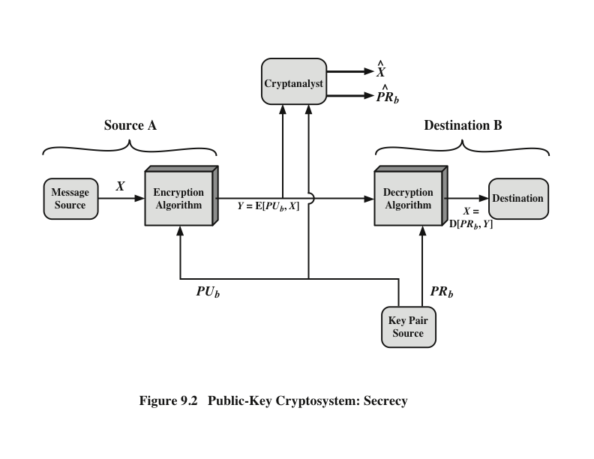
Public-Key Cryptosystem: Secrecy
Notes:
Let us take a closer look at the essential elements of a public-key encryption
scheme, using Figure 9.2 (compare with Figure 3.2).
The scheme illustrated in Figure 9.2 provides confidentiality.

Slide 10
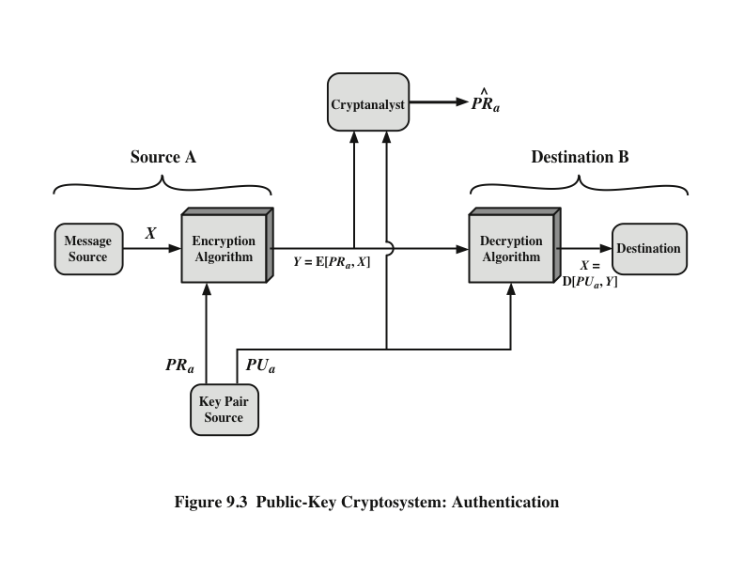
Public-Key Cryptosystem: Authentication
Notes:
We mentioned earlier that either of the two related keys can be used for encryption,
with the other being used for decryption. This enables a rather different
cryptographic scheme to be implemented. Whereas the scheme illustrated in
Figure 9.2 provides confidentiality, Figures 9.1b and 9.3 show the use of public-key
encryption to provide authentication.
It is important to emphasize that the encryption process depicted in
Figures 9.1b and 9.3 does not provide confidentiality. That is, the message being
sent is safe from alteration but not from eavesdropping. This is obvious in the
case of a signature based on a portion of the message, because the rest of the
message is transmitted in the clear. Even in the case of complete encryption,
as shown in Figure 9.3, there is no protection of confidentiality because any
observer can decrypt the message by using the sender’s public key.

Slide 11
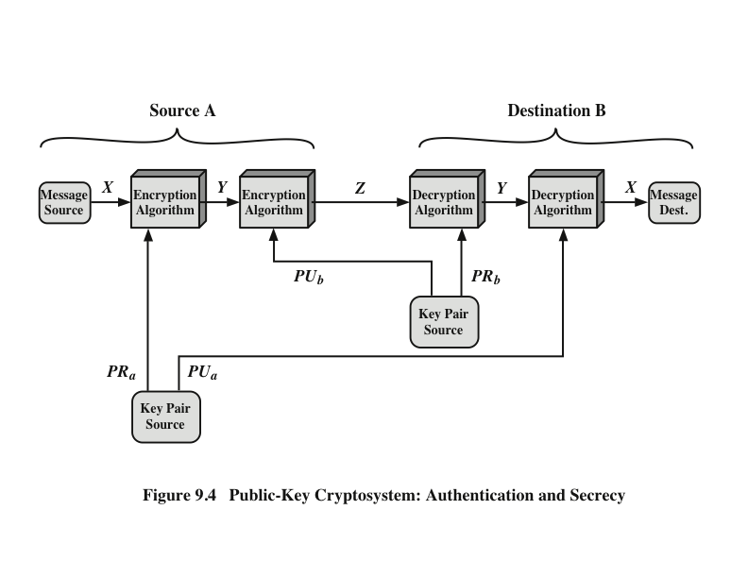
Public-Key Cryptosystem: Authentication and Secrecy
Notes:
It is, however, possible to provide both the authentication function and confidentiality
by a double use of the public-key scheme (Figure 9.4).
In this case, we begin as before by encrypting a message, using the sender’s private
key. This provides the digital signature. Next, we encrypt again, using the receiver’s
public key. The final ciphertext can be decrypted only by the intended receiver, who
alone has the matching private key. Thus, confidentiality is provided. The disadvantage
of this approach is that the public-key algorithm, which is complex, must be
exercised four times rather than two in each communication.

Slide 12
Applications for Public-Key Cryptosystems
Public-key cryptosystems can be classified into three categories:
Some algorithms are suitable for all three applications, whereas others can be used only for one or two
Notes:
Before proceeding, we need to clarify one aspect of public-key cryptosystems that is
otherwise likely to lead to confusion. Public-key systems are characterized by the use
of a cryptographic algorithm with two keys, one held private and one available publicly.
Depending on the application, the sender uses either the sender’s private key or
the receiver’s public key, or both, to perform some type of cryptographic function. In
broad terms, we can classify the use of public-key cryptosystems into three categories
• Encryption/decryption: The sender encrypts a message with the recipient’s
public key.
• Digital signature: The sender “signs” a message with its private key. Signing
is achieved by a cryptographic algorithm applied to the message or to a small
block of data that is a function of the message.
• Key exchange: Two sides cooperate to exchange a session key. Several different
approaches are possible, involving the private key(s) of one or both parties.

Slide 13
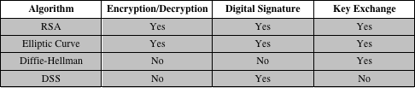
Table 9.3
Applications for Public-Key Cryptosystems
Table 9.3 Applications for Public-Key Cryptosystems
Notes:
Some algorithms are suitable for all three applications, whereas others can be
used only for one or two of these applications. Table 9.3 indicates the applications
supported by the algorithms discussed in this book.

Slide 14
Public-Key Requirements
Conditions that these algorithms must fulfill:
  It is computationally easy for a party B to generate a pair (public-key PU_{b}, private key PR_{b})
  It is computationally easy for a sender A, knowing the public key and the message to be encrypted, to generate the corresponding ciphertext
  It is computationally easy for the receiver B to decrypt the resulting ciphertext using the private key to recover the original message
  It is computationally infeasible for an adversary, knowing the public key, to determine the private key
  It is computationally infeasible for an adversary, knowing the public key and a ciphertext, to recover the original message
  The two keys can be applied in either order
Notes:
The cryptosystem illustrated in Figures 9.2 through 9.4 depends on a cryptographic algorithm based on two related keys. Diffie and Hellman postulated this system without demonstrating that such algorithms exist. However, they did lay out the conditions that such algorithms must fulfill:
It is computationally easy for a party B to generate a pair (public key PU_{b}, private key PR_{b}).
It is computationally easy for a sender A, knowing the public key and the message to be encrypted, M, to generate the corresponding ciphertext:
C = E(PU_{b}, M)
3. It is computationally easy for the receiver B to decrypt the resulting ciphertext using the private key to recover the original message: M = D(PR_{b}, C) = D[PR_{b}, E(PU_{b}, M)
4. It is computationally infeasible for an adversary, knowing the public key, PU_{b}, to determine the private key, PR_{b}
5. It is computationally infeasible for an adversary, knowing the public key, PU_{b}, and a ciphertext, C, to recover the original message, M.
6. (optional) The two keys can be applied in either order:
M = D[PU_{b} , E(PR_{b}, M)] = D[PR_{b}, E(PU_{b}, M)]
These are formidable requirements, as evidenced by the fact that only a few algorithms (RSA, elliptic curve cryptography, Diffie-Hellman, DSS) have received widespread acceptance in the several decades since the concept of public-key cryptography was proposed.

Slide 15
Public-Key Requirements
Need a trap-door one-way function
  A one-way function is one that maps a domain into a range such that every function value has a unique inverse, with the condition that the calculation of the function is easy, whereas the calculation of the inverse is infeasible
    Y = f(X) easy
    X = f^{–1}(Y) infeasible
A trap-door one-way function is a family of invertible functions f_{k}, such that
  Y = f_{k}(X) easy, if k and X are known
  X = f_{k}^{–1}(Y) easy, if k and Y are known
  X = f_{k}^{–1}(Y) infeasible, if Y known but k not known
A practical public-key scheme depends on a suitable trap-door one-way function
Notes:
Before elaborating on why the requirements are so formidable, let us first recast
them. The requirements boil down to the need for a trap-door one-way function.
A one-way function is one that maps a domain into a range such that every
function value has a unique inverse, with the condition that the calculation of the
function is easy, whereas the calculation of the inverse is infeasible
Y = f(X) easy
X = f^{–1}(Y) infeasible
Generally, easy is defined to mean a problem that can be solved in polynomial
time as a function of input length. Thus, if the length of the input is n bits, then the
time to compute the function is proportional to nª , where a is a fixed constant. Such
algorithms are said to belong to the class P . The term infeasible is a much fuzzier
concept. In general, we can say a problem is infeasible if the effort to solve it grows
faster than polynomial time as a function of input size. For example, if the length
of the input is n bits and the time to compute the function is proportional to 2^{n} ,
the problem is considered infeasible. Unfortunately, it is difficult to determine if a
particular algorithm exhibits this complexity. Furthermore, traditional notions of
computational complexity focus on the worst-case or average-case complexity of
an algorithm. These measures are inadequate for cryptography, which requires that
it be infeasible to invert a function for virtually all inputs, not for the worst case or
even average case. A brief introduction to some of these concepts is provided in
Appendix 9A.
We now turn to the definition of a trap-door one-way function , which is easy
to calculate in one direction and infeasible to calculate in the other direction unless
certain additional information is known. With the additional information the
inverse can be calculated in polynomial time. We can summarize as follows: A trapdoor
one-way function is a family of invertible functions f_{k} , such that
Y = f_{k}(X) easy, if k and X are known
X = f_{k}^{–1}(Y) easy, if k and Y are known
X = f_{k}^{–1}(Y) infeasible, if Y known but k not known
Thus, the development of a practical public-key scheme depends on discovery of a suitable trap-door one-way function.

Slide 16

Public-Key Cryptanalysis
A public-key encryption scheme is vulnerable to a brute-force attack
  Countermeasure: use large keys
  Key size must be small enough for practical encryption and decryption
  Key sizes that have been proposed result in encryption/decryption speeds that are too slow for general-purpose use
  Public-key encryption is currently confined to key management and signature applications
  Another form of attack is to find some way to compute the private key given the public key
  To date it has not been mathematically proven that this form of attack is infeasible for a particular public-key algorithm
  Finally, there is a probable-message attack
  This attack can be thwarted by appending some random bits to simple messages
Notes:
As with symmetric encryption, a public-key encryption scheme is vulnerable to a
brute-force attack. The countermeasure is the same: Use large keys. However, there
is a tradeoff to be considered. Public-key systems depend on the use of some sort of
invertible mathematical function. The complexity of calculating these functions may
not scale linearly with the number of bits in the key but grow more rapidly than that.
Thus, the key size must be large enough to make brute-force attack impractical but
small enough for practical encryption and decryption. In practice, the key sizes that
have been proposed do make brute-force attack impractical but result in encryption/
decryption speeds that are too slow for general-purpose use. Instead, as was mentioned
earlier, public-key encryption is currently confined to key management and
signature applications.
Another form of attack is to find some way to compute the private key given
the public key. To date, it has not been mathematically proven that this form of attack
is infeasible for a particular public-key algorithm. Thus, any given algorithm,
including the widely used RSA algorithm, is suspect. The history of cryptanalysis
shows that a problem that seems insoluble from one perspective can be found to
have a solution if looked at in an entirely different way.
Finally, there is a form of attack that is peculiar to public-key systems. This is,
in essence, a probable-message attack. Suppose, for example, that a message were to
be sent that consisted solely of a 56-bit DES key. An adversary could encrypt all possible
56-bit DES keys using the public key and could discover the encrypted key by
matching the transmitted ciphertext. Thus, no matter how large the key size of the
public-key scheme, the attack is reduced to a brute-force attack on a 56-bit key. This
attack can be thwarted by appending some random bits to such simple messages.

Slide 17
Rivest-Shamir-Adleman (RSA) Algorithm
Developed in 1977 at MIT by Ron Rivest, Adi Shamir & Len Adleman
Most widely used general-purpose approach to public-key encryption
Is a cipher in which the plaintext and ciphertext are integers between 0 and n – 1 for some n
  A typical size for n is 1024 bits, or 309 decimal digits
Notes:
The pioneering paper by Diffie and Hellman [DIFF76b] introduced a new approach
to cryptography and, in effect, challenged cryptologists to come up with a cryptographic
algorithm that met the requirements for public-key systems. A number of
algorithms have been proposed for public-key cryptography. Some of these, though
initially promising, turned out to be breakable.
One of the first successful responses to the challenge was developed in 1977
by Ron Rivest, Adi Shamir, and Len Adleman at MIT and first published in 1978
[RIVE78]. The Rivest-Shamir-Adleman (RSA) scheme has since that time reigned
supreme as the most widely accepted and implemented general-purpose approach
to public-key encryption.
The RSA scheme is a cipher in which the plaintext and ciphertext are integers
between 0 and n - 1 for some n . A typical size for n is 1024 bits, or 309 decimal
digits. That is, n is less than 2¹⁰²⁴ . We examine RSA in this section in some detail,
beginning with an explanation of the algorithm. Then we examine some of the computational
and cryptanalytical implications of RSA.

Slide 18
RSA Algorithm
RSA makes use of an expression with exponentials
Plaintext is encrypted in blocks with each block having a binary value less than some number n
Encryption and decryption are of the following form, for some plaintext block M and ciphertext block C
C = Me mod n
M = C^{d} mod n = (Me)^{d} mod n = M^{ed} mod n
Both sender and receiver must know the value of n
The sender knows the value of e, and only the receiver knows the value of d
This is a public-key encryption algorithm with a public key of PU={e,n} and a private key of PR={d,n}
Notes:
RSA makes use of an expression with exponentials. Plaintext is encrypted in blocks,
with each block having a binary value less than some number n . That is, the block
size must be less than or equal to log₂ (n ) + 1; in practice, the block size is i bits,
where 2^{i} < n ≤ 2^{i+1} . Encryption and decryption are of the following form, for some
plaintext block M and ciphertext block C.
C = Me mod n
M = C^{d} mod n = (Me )^{d} mod n = M^{ed} mod n
Both sender and receiver must know the value of n . The sender knows the
value of e , and only the receiver knows the value of d . Thus, this is a public-key encryption
algorithm with a public key of PU = {e , n } and a private key of PR = {d , n }.

Slide 19

Algorithm Requirements
For this algorithm to be satisfactory for public-key encryption, the following requirements must be met:
1. It is possible to find values of e, d, n such that M^{ed} mod n = M for all M < n
2. It is relatively easy to calculate Me mod n and C^{d} mod n for all values of M < n
3. It is infeasible to determine d given e and n
Notes:
For this algorithm to be satisfactory for public-key encryption, the following requirements
must be met.
1. It is possible to find values of e , d , n such that M^{ed} mod n = M for all M < n .
2. It is relatively easy to calculate Me mod n and C^{d} mod n for all values of M < n .
3. It is infeasible to determine d given e and n .

Slide 20
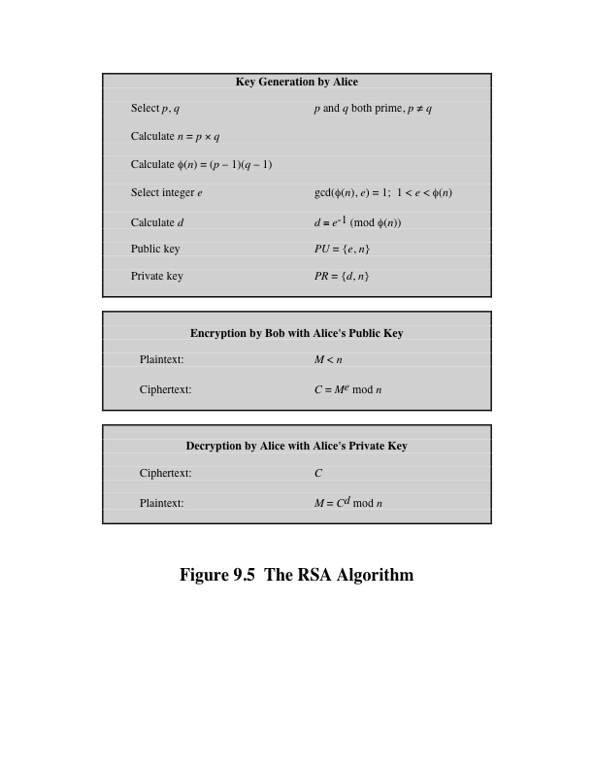
Notes:
Figure 9.5 summarizes the RSA algorithm. It corresponds to Figure 9.1a: Alice
generates a public/private key pair; Bob encrypts using Alice’s public key; and Alice
decrypts using her private key.

Slide 21
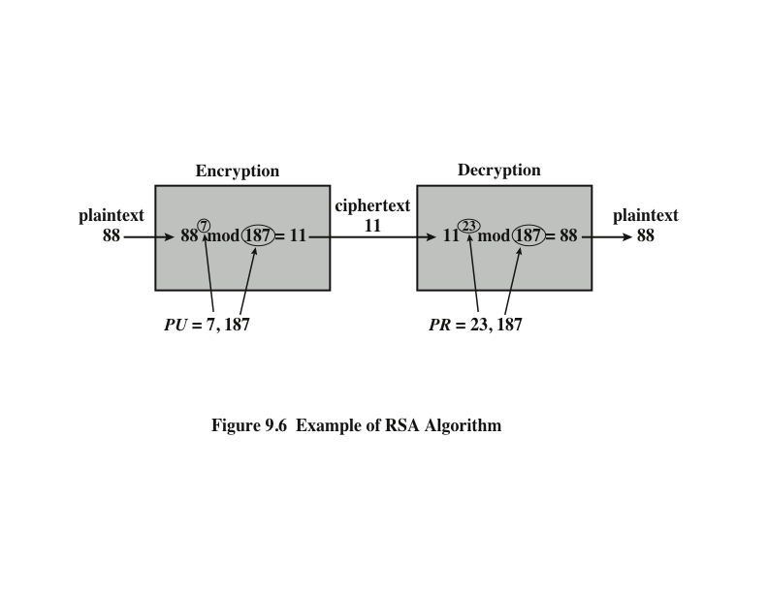
Example of RSA Algorithm
Notes:
An example from [SING99] is shown in Figure 9.6.

Slide 22
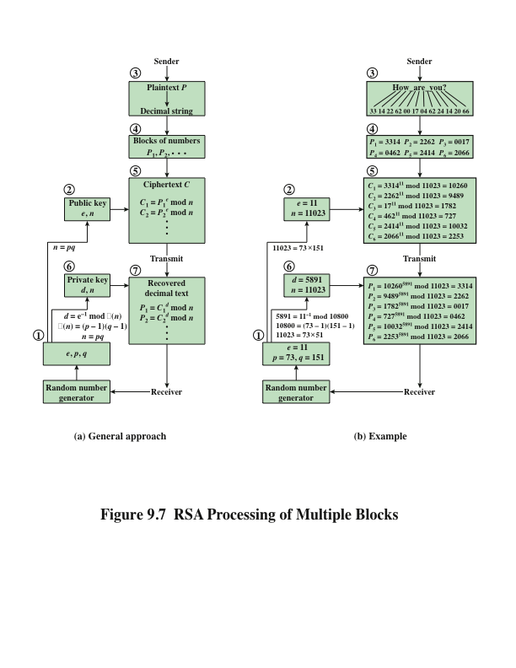
Notes:
Figure 9.7a illustrates the sequence of events for the
encryption of multiple blocks, and Figure 9.7b gives a specific example. The circled
numbers indicate the order in which operations are performed.

Slide 23
Exponentiation in Modular Arithmetic
Both encryption and decryption in RSA involve raising an integer to an integer power, mod n
Can make use of a property of modular arithmetic:
[(a mod n) x (b mod n)] mod n =(a x b) mod n
With RSA you are dealing with potentially large exponents so efficiency of exponentiation is a consideration
Notes:
Both encryption and decryption in RSA
involve raising an integer to an integer power, mod n . If the exponentiation is done
over the integers and then reduced modulo n , the intermediate values would be
gargantuan. Fortunately, as the preceding example shows, we can make use of a
property of modular arithmetic:
[(a mod n ) * (b mod n )] mod n = (a * b ) mod n
Thus, we can reduce intermediate results modulo n . This makes the calculation
practical.
Another consideration is the efficiency of exponentiation, because with RSA,
we are dealing with potentially large exponents. To see how efficiency might be increased,
consider that we wish to compute x¹⁶ . A straightforward approach requires
15 multiplications:
x¹⁶ = x * x * x * x * x * x * x * x * x * x * x * x * x * x * x * x
However, we can achieve the same final result with only four multiplications if we
repeatedly take the square of each partial result, successively forming (x² , x⁴ , x⁸ , x¹⁶ ).

Slide 24
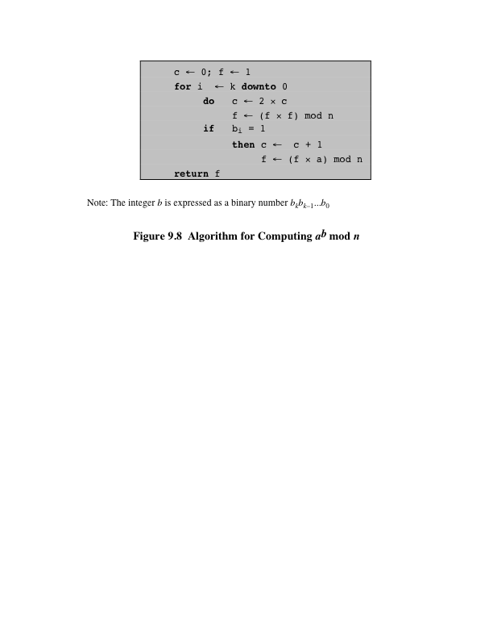
Notes:
We can therefore develop the algorithm for computing a^{b} mod n, shown in
Figure 9.8.

Slide 25
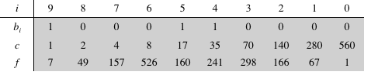
Table 9.4
Notes:
Table 9.4 shows an example of the execution of this algorithm. Note that
the variable c is not needed; it is included for explanatory purposes. The final value
of c is the value of the exponent.

Slide 26
Efficient Operation Using the Public Key
To speed up the operation of the RSA algorithm using the public key, a specific choice of e is usually made
The most common choice is 65537 (2¹⁶ + 1)
  Two other popular choices are e=3 and e=17
  Each of these choices has only two 1 bits, so the number of multiplications required to perform exponentiation is minimized
  With a very small public key, such as e = 3, RSA becomes vulnerable to a simple attack
Notes:
To speed up the operation of the RSA algorithm using the public key, can choose to use a small value of e. The most common choice is 65537 (2¹⁶ + 1); two other popular choices are 3 and 17. Each of these choices has only two 1 bits and so the number of multiplications required to perform exponentiation is minimized.
However, with a very small public key, such as e = 3, RSA becomes vulnerable to a simple attack.

Slide 27
Efficient Operation Using the Private Key
Decryption uses exponentiation to power d
  A small value of d is vulnerable to a brute-force attack and to other forms of cryptanalysis
Can use the Chinese Remainder Theorem (CRT) to speed up computation
  The quantities d mod (p – 1) and d mod (q – 1) can be precalculated
  End result is that the calculation is approximately four times as fast as evaluating M = C^{d} mod n directly
Notes:
We cannot similarly choose a small constant value of d for efficient operation. A small value of d is vulnerable to a brute-force attack and to other forms of cryptanalysis [WIEN90]. However, there is a way to speed up computation using the CRT.
The quantities d mod (p - 1) and d mod (q - 1) can be precalculated. The end
result is that the calculation is approximately four times as fast as evaluating M = C^{d}
mod n directly [BONE02].

Slide 28
Key Generation
Before the application of the public-key cryptosystem each participant must generate a pair of keys:
  Determine two prime numbers p and q
  Select either e or d and calculate the other
Because the value of n = pq will be known to any potential adversary, primes must be chosen from a sufficiently large set
  The method used for finding large primes must be reasonably efficient
Notes:
Before the application of the public-key cryptosystem, each
participant must generate a pair of keys. This involves the following tasks.
• Determining two prime numbers, p and q.
• Selecting either e or d and calculating the other.
First, consider the selection of p and q . Because the value of n = pq will be
known to any potential adversary, in order to prevent the discovery of p and q by
exhaustive methods, these primes must be chosen from a sufficiently large set (i.e.,
p and q must be large numbers). On the other hand, the method used for finding
large primes must be reasonably efficient.
At present, there are no useful techniques that yield arbitrarily large primes,
so some other means of tackling the problem is needed. The procedure that is generally
used is to pick at random an odd number of the desired order of magnitude
and test whether that number is prime. If not, pick successive random numbers until
one is found that tests prime.
A variety of tests for primality have been developed (e.g., see [KNUT98] for
a description of a number of such tests). Almost invariably, the tests are probabilistic.
That is, the test will merely determine that a given integer is probably prime.
Despite this lack of certainty, these tests can be run in such a way as to make the
probability as close to 1.0 as desired. As an example, one of the more efficient
and popular algorithms, the Miller-Rabin algorithm, is described in Chapter 2.
With this algorithm and most such algorithms, the procedure for testing whether
a given integer n is prime is to perform some calculation that involves n and a
randomly chosen integer a . If n “fails” the test, then n is not prime. If n “passes”
the test, then n may be prime or nonprime. If n passes many such tests with many
different randomly chosen values for a , then we can have high confidence that n
is, in fact, prime.

Slide 29
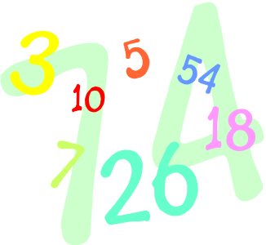
Procedure for Picking a Prime Number
Pick an odd integer n at random
Pick an integer a < n at random
Perform the probabilistic primality test with a as a parameter. If n fails the test, reject the value n and go to step 1
If n has passed a sufficient number of tests, accept n; otherwise, go to step 2
Notes:
In summary, the procedure for picking a prime number is as follows.
1. Pick an odd integer n at random (e.g., using a pseudorandom number
generator).
2. Pick an integer a < n at random.
3. Perform the probabilistic primality test, such as Miller-Rabin, with a as a
parameter. If n fails the test, reject the value n and go to step 1.
4. If n has passed a sufficient number of tests, accept n ; otherwise, go to step 2.

Slide 30
The Security of RSA
Notes:
Five possible approaches to attacking the RSA algorithm are
■ Brute force: This involves trying all possible private keys.
■ Mathematical attacks: There are several approaches, all equivalent in effort to
factoring the product of two primes.
■ Timing attacks: These depend on the running time of the decryption algorithm.
■ Hardware fault-based attack: This involves inducing hardware faults in the
processor that is generating digital signatures.
■ Chosen ciphertext attacks: This type of attack exploits properties of the RSA
algorithm.
The defense against the brute-force approach is the same for RSA as for other cryptosystems, namely, use a large key space. Thus the larger the number of bits in d, the better. However because the calculations involved both in key generation and in encryption/decryption are complex, the larger the size of the key, the slower the system will run.

Slide 31
Factoring Problem
We can identify three approaches to attacking RSA mathematically:
  Factor n into its two prime factors. This enables calculation of ø(n) = (p – 1) x (q – 1), which in turn enables determination of d = e⁻¹ (mod ø(n))
  Determine ø(n) directly without first determining p and q. Again this enables determination of d = e⁻¹ (mod ø(n))
  Determine d directly without first determining ø(n)
Notes:
We can identify three approaches to attacking RSA mathematically:
Factor n into its two prime factors. This enables calculation of ø(n) = (p – 1) x (q – 1), which in turn enables determination of d = e⁻¹ (mod ø(n))
Determine ø(n) directly without first determining p and q. Again this enables determination of d = e⁻¹ (mod ø(n))
Determine d directly without first determining ø(n)

Slide 32
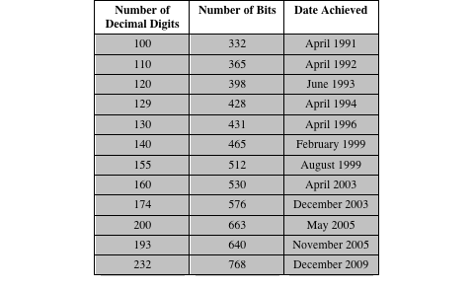
Table 9.5 Progress in RSA Factorization
Notes:
Table 9.5 Progress in RSA Factorization
A striking fact about the progress reflected in Table 9.5 concerns the method
used. Until the mid-1990s, factoring attacks were made using an approach known
as the quadratic sieve. The attack on RSA-130 used a newer algorithm, the generalized
number field sieve (GNFS), and was able to factor a larger number than RSA-
129 at only 20% of the computing effort.

Slide 33
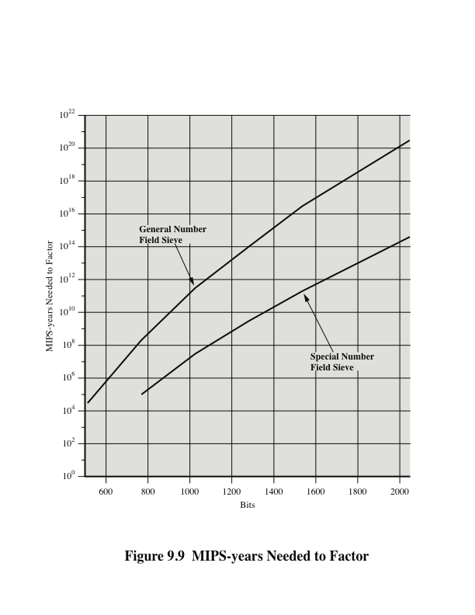
Notes:
The threat to larger key sizes is twofold: the continuing increase in computing
power and the continuing refinement of factoring algorithms. We have seen
that the move to a different algorithm resulted in a tremendous speedup. We
can expect further refinements in the GNFS, and the use of an even better algorithm
is also a possibility. In fact, a related algorithm, the special number field
sieve (SNFS), can factor numbers with a specialized form considerably faster
than the generalized number field sieve. Figure 9.9 compares the performance
of the two algorithms. It is reasonable to expect a breakthrough that would enable
a general factoring performance in about the same time as SNFS, or even
better [ODLY95]. Thus, we need to be careful in choosing a key size for RSA.

Slide 34

Timing Attacks
Paul Kocher, a cryptographic consultant, demonstrated that a snooper can determine a private key by keeping track of how long a computer takes to decipher messages
Are applicable not just to RSA but to other public-key cryptography systems
Are alarming for two reasons:
  It comes from a completely unexpected direction
  It is a ciphertext-only attack
Notes:
If one needed yet another lesson about how difficult it is to
assess the security of a cryptographic algorithm, the appearance of timing attacks
provides a stunning one. Paul Kocher, a cryptographic consultant, demonstrated
that a snooper can determine a private key by keeping track of how long a computer
takes to decipher messages [KOCH96, KALI96b]. Timing attacks are applicable
not just to RSA, but to other public-key cryptography systems. This attack is alarming
for two reasons: It comes from a completely unexpected direction, and it is a
ciphertext-only attack.
A timing attack is somewhat analogous to a burglar guessing the combination
of a safe by observing how long it takes for someone to turn the dial from number
to number. We can explain the attack using the modular exponentiation algorithm
of Figure 9.8, but the attack can be adapted to work with any implementation that
does not run in fixed time. In this algorithm, modular exponentiation is accomplished
bit by bit, with one modular multiplication performed at each iteration and
an additional modular multiplication performed for each 1 bit.

Slide 35
Countermeasures
Notes:
Although the timing attack is a serious threat, there are simple countermeasures
that can be used, including the following.
• Constant exponentiation time: Ensure that all exponentiations take the same
amount of time before returning a result. This is a simple fix but does degrade
performance.
• Random delay: Better performance could be achieved by adding a random
delay to the exponentiation algorithm to confuse the timing attack. Kocher
points out that if defenders don’t add enough noise, attackers could still succeed
by collecting additional measurements to compensate for the random delays.
• Blinding: Multiply the ciphertext by a random number before performing
exponentiation. This process prevents the attacker from knowing what ciphertext
bits are being processed inside the computer and therefore prevents the
bit-by-bit analysis essential to the timing attack.

Slide 36
Fault-Based Attack
An attack on a processor that is generating RSA digital signatures
  Induces faults in the signature computation by reducing the power to the processor
  The faults cause the software to produce invalid signatures which can then be analyzed by the attacker to recover the private key
The attack algorithm involves inducing single-bit errors and observing the results
While worthy of consideration, this attack does not appear to be a serious threat to RSA
  It requires that the attacker have physical access to the target machine and is able to directly control the input power to the processor
Notes:
Still another unorthodox approach to attacking RSA is reported
in [PELL10]. The approach is an attack on a processor that is generating
RSA digital signatures. The attack induces faults in the signature computation by
reducing the power to the processor. The faults cause the software to produce invalid
signatures, which can then be analyzed by the attacker to recover the private
key. The authors show how such an analysis can be done and then demonstrate it
by extracting a 1024-bit private RSA key in approximately 100 hours, using a commercially
available microprocessor.
The attack algorithm involves inducing single-bit errors and observing the results.
The details are provided in [PELL10], which also references other proposed
hardware fault-based attacks against RSA.
This attack, while worthy of consideration, does not appear to be a serious
threat to RSA. It requires that the attacker have physical access to the target
machine and that the attacker is able to directly control the input power to the
processor. Controlling the input power would for most hardware require more than
simply controlling the AC power, but would also involve the power supply control
hardware on the chip.

Slide 37
Chosen Ciphertext Attack (CCA)
The adversary chooses a number of ciphertexts and is then given the corresponding plaintexts, decrypted with the target’s private key
  Thus the adversary could select a plaintext, encrypt it with the target’s public key, and then be able to get the plaintext back by having it decrypted with the private key
  The adversary exploits properties of RSA and selects blocks of data that, when processed using the target’s private key, yield information needed for cryptanalysis
  To counter such attacks, RSA Security Inc. recommends modifying the plaintext using a procedure known as optimal asymmetric encryption padding (OAEP)
Notes:
The basic RSA algorithm is vulnerable to a chosen ciphertext attack (CCA). CCA is
defined as an attack in which the adversary chooses a number of ciphertexts and
is then given the corresponding plaintexts, decrypted with the target’s private key.
Thus, the adversary could select a plaintext, encrypt it with the target’s public key,
and then be able to get the plaintext back by having it decrypted with the private
key. Clearly, this provides the adversary with no new information. Instead, the adversary
exploits properties of RSA and selects blocks of data that, when processed
using the target’s private key, yield information needed for cryptanalysis.
To counter such attacks, RSA Security Inc., a leading RSA vendor and former holder
of the RSA patent, recommends modifying the plaintext using a procedure known
as optimal asymmetric encryption padding (OAEP). A full discussion of the threats
and OAEP are beyond our scope; see [POIN02] for an introduction and [BELL94a]
for a thorough analysis. Here, we simply summarize the OAEP procedure.

Slide 38
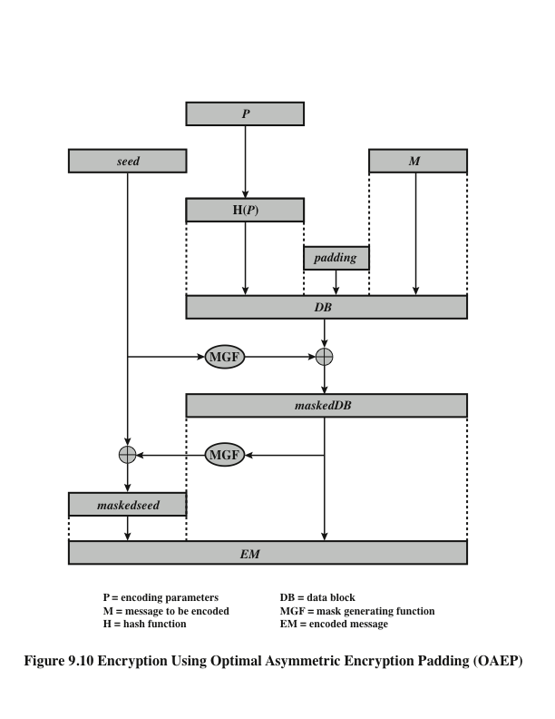
Optimal Asymmetric Encryption Padding (OAEP)
Notes:
Figure 9.10 depicts OAEP encryption. As a first step, the message M to be
encrypted is padded. A set of optional parameters, P , is passed through a hash
function, H. The output is then padded with zeros to get the desired length in the
overall data block (DB). Next, a random seed is generated and passed through
another hash function, called the mask generating function (MGF). The resulting
hash value is bit-by-bit XORed with DB to produce a maskedDB. The maskedDB
is in turn passed through the MGF to form a hash that is XORed with the seed
to produce the masked seed. The concatenation of the masked-seed and the
maskedDB forms the encoded message EM. Note that the EM includes the padded
message, masked by the seed, and the seed, masked by the maskedDB. The EM is
then encrypted using RSA.

Slide 39
Summary
Public-key cryptosystems
Applications for public-key cryptosystems
Requirements for public-key cryptography
Public-key cryptanalysis
The RSA algorithm
  Description of the algorithm
  Computational aspects
  Security of RSA
Notes:
Chapter 9 summary.

